Slide 1



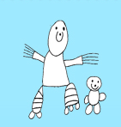
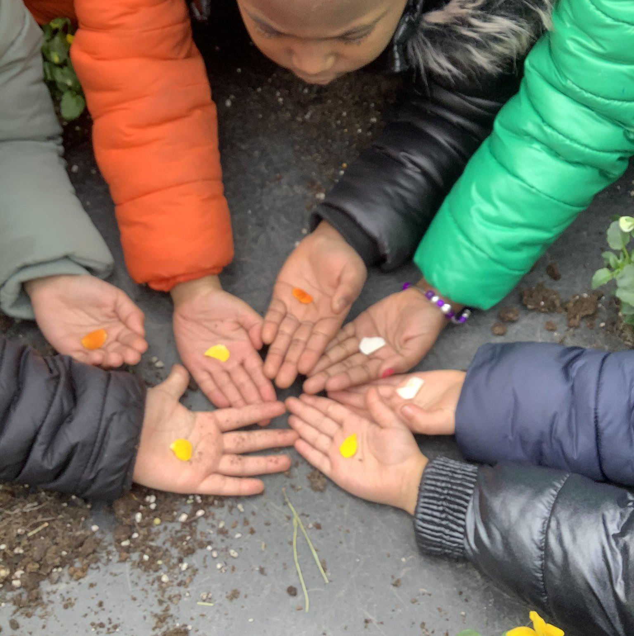



principles
RelationshIPS EDUCATION
Parent/carer leaflet
safety
respect
health
Celebrating diversity
Inclusion & fairness
We will ensure that the information that we are sharing with children is factually correct and respectful of cultural and faith differences
We will ensure children know how to treat each other respectfully
We will help prepare our older children for the changes in their own bodies and emotions as they get older
Know that they should be safe from harm
We will help children to understand that we all have different needs yet we all have the same rights
Tremorfa Nursery
School

Slide 2
RSE
approaches
Relationships & identity
Sexual health & wellbeing
empathy , safety & respect
From September 2022 the school will be implementing a new approach to relationships education. We are basing our approach on Welsh Government guidance and principles that we have agreed in our local cluster of schools.
In the ‘Relationships and Identity’ strand children in our school will build on their learning about empathy, how to maintain friendships, to share, to listen to each other, and think about ways of resolving conflict. They will think about different types of families. They will also learn about fairness and discrimination and to think about stereotypes. Lots of learning in this strand overlaps with the Health & Wellbeing and Humanities areas of learning and experience.
In the ‘Sexual Health & Well-being’ strand children will learn about life cycles and about how all living things grow and change. They will learn about the importance of staying healthy and looking after themselves. Younger children will learn that they were once babies, they may watch chicks hatch or tadpoles change into frogs. Older children will learn about puberty, menstruation and reproduction. Much of what is covered in this strand is also covered in Science and Technology.
In the ‘Empathy, Safety and Respect’ strand children will learn about treating others fairly. They will consider discrimination and how that makes people feel. They will learn how to be a good friend and that bullying or hurting others is not ok. They will also learn about their right to bodily privacy, consent and which parts of the body are private. They will learn who they can talk to if they need help. Again, there is lots of overlap with what we will be talking about in Humanities and Health & Wellbeing
Restorative
Creative
Developmentally Appropriate
Child Influenced
Incidental
Environmental
Transparent
Relationships and Sexuality Education covers many different topics, all of which overlap with other areas of learning and experience from the Curriculum for Wales. The guidance covers three strands of learning:
Mercury is the closest planet to the Sun and the smallest one in the Solar System—it’s only a bit larger than the Moon

