Slide 1
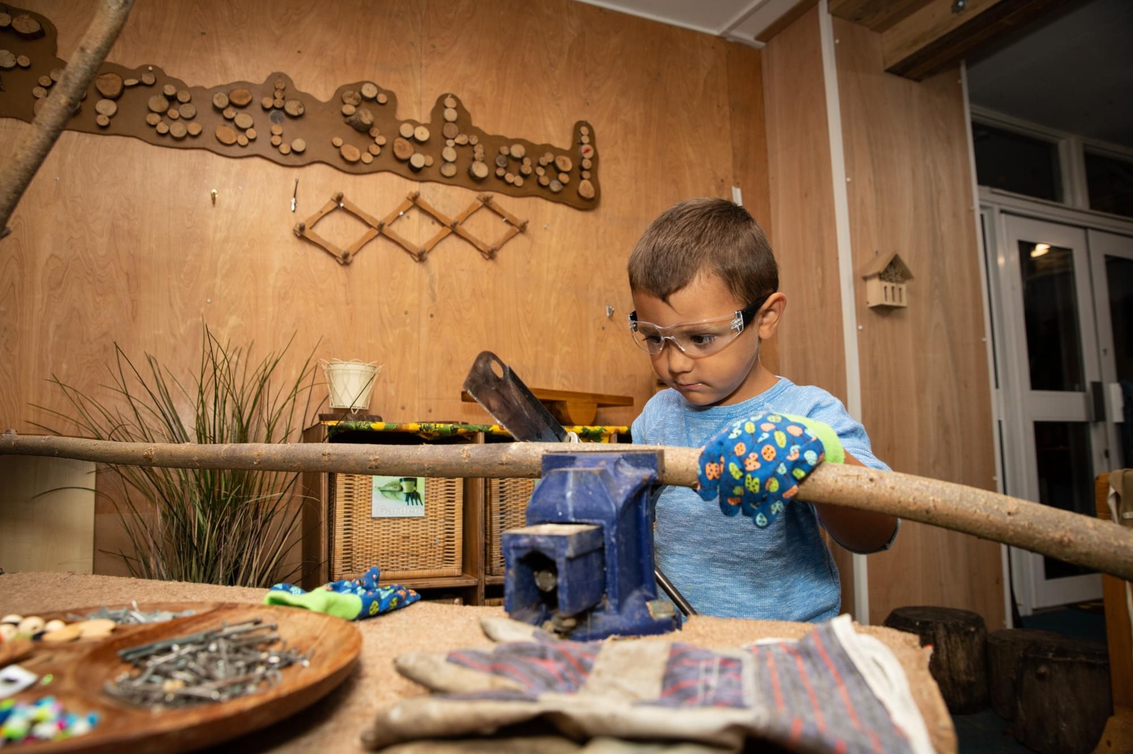
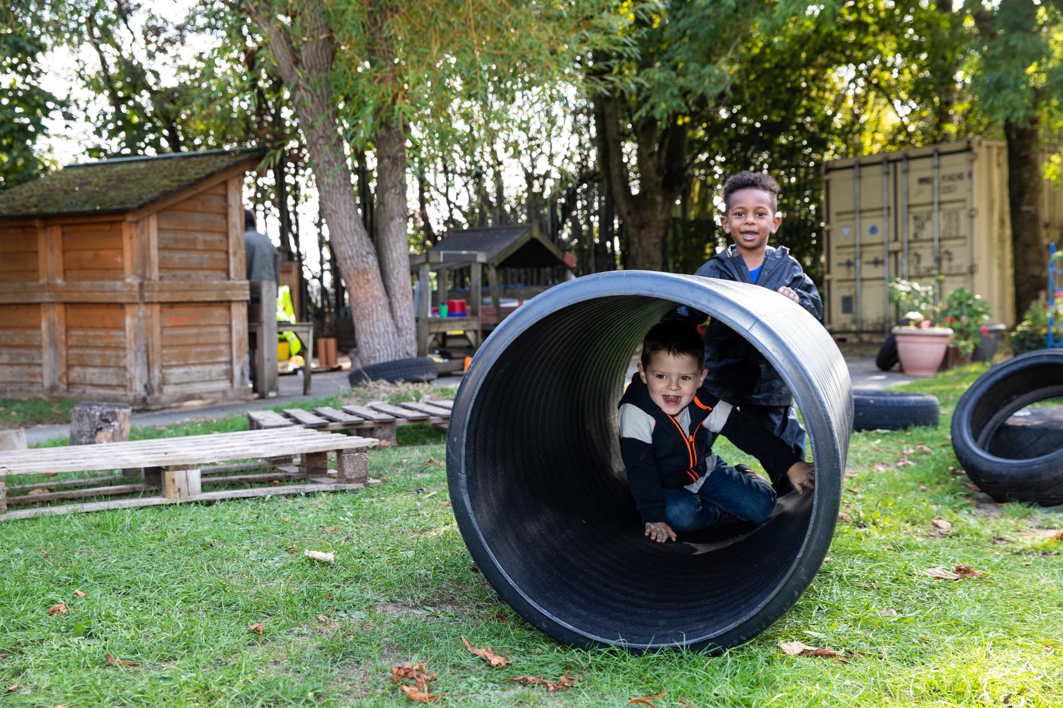
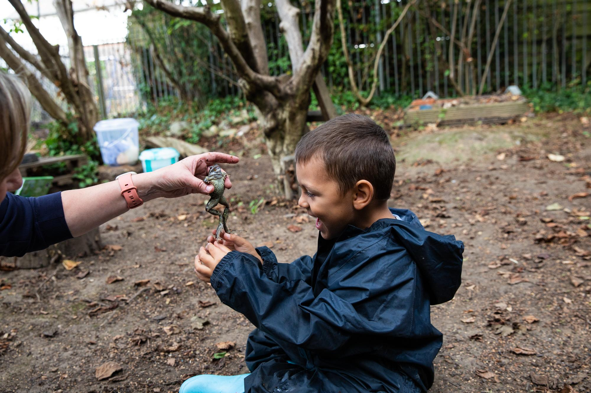
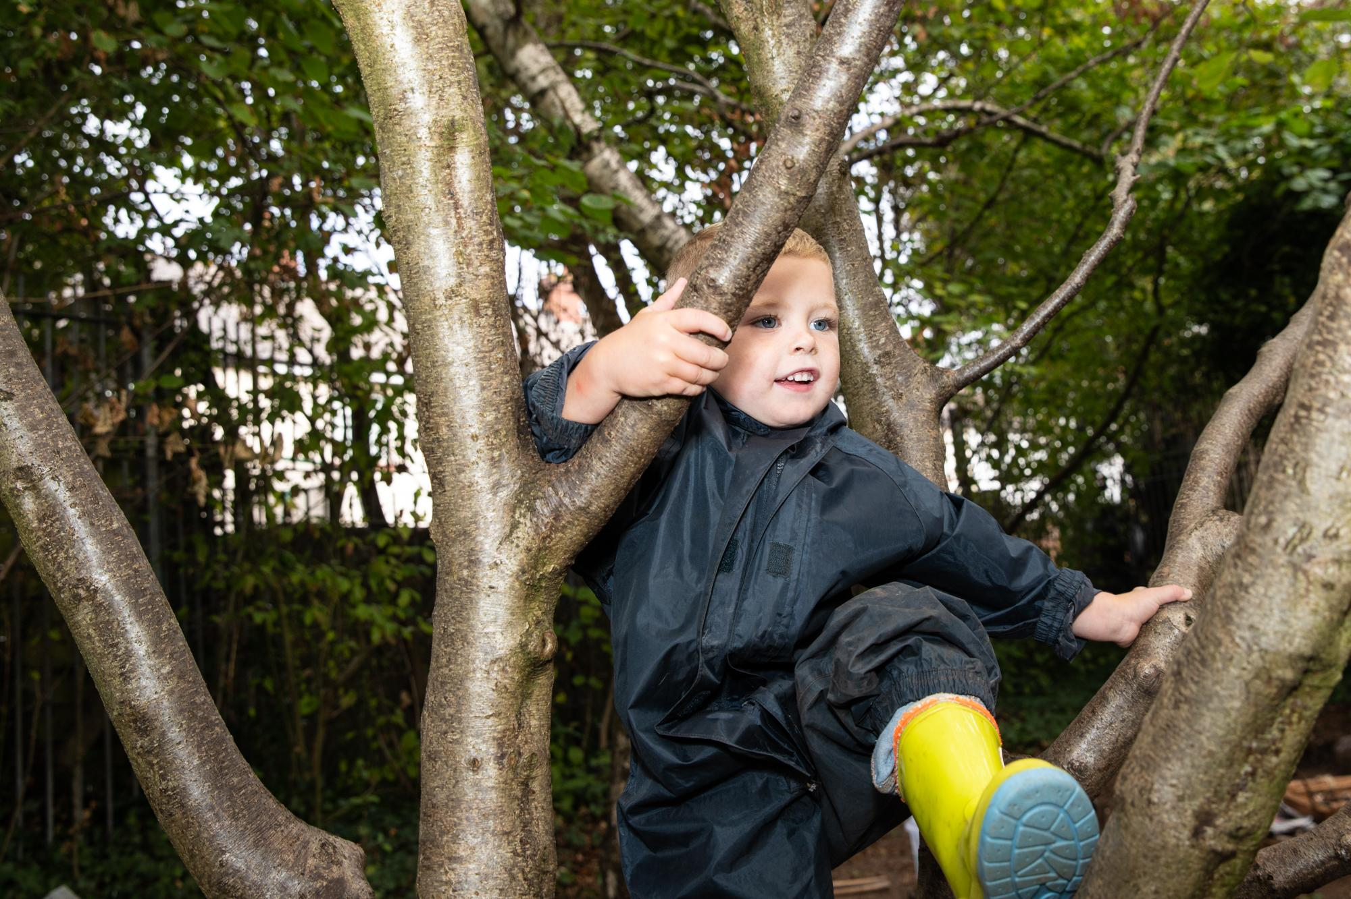
Tremorfa Nursery School
Prospectus
Tremorfa Nursery School 029 2046 2581
Willows Avenue www.tremorfanursery.co.uk
Cardiff CF24 2EY
Email: tremorfanursery@cardiff.gov.uk Headteacher: Mrs Samantha Jones

Slide 2
A very warm welcome
Welcome to Tremorfa Nursery School. We hope that you will find this time with us a happy start to your child’s school life. This prospectus aims to help you to understand how our Nursery is organised, how to support your child with transition and enable him/her to get the most from time spent here.
If you have anything you wish to ask, approach the staff at the beginning or end of the nursery session, the staff will help in any way possible.
Our Nursery School has places for 60 children at a time, who attend for either 5 morning or 5 afternoon sessions a week.
When your child is admitted to Nursery he or she will be allocated to a POD (Plan of Day) group which will be lead by either a teacher or senior teaching assistant taking particular responsibility for him/her.

Slide 3
Who is who?
Nursery Team
Sam Jones Headteacher
Polly Moakes ALNCo / Senior Teacher
Sally Angell-Fox ALNCo/Senior Teacher
Ellen Maddocks Teacher
Beth Williams Teacher
Clare Runza Teacher
Gaynor Light Teaching Assistant
Megan Burns Teaching Assistant/Breakfast Club
Annie Morgan School Clerk
Governing Body
Hannah Chivers Chair of Governor
Annie Morgan Clerk to Governors
Samantha Jones Headteacher
Sarah Fitzgibbon Vice Chair of Governors
Clare Runza Teacher Governor
Megan Burns Staff Governor
Sarah MacKay Community Governor
Joanna May Community Governor
Nicola Ward Parent Governor
Gina Rooke-Rendall Parent Governor
Annabelle Llanes Parent Governor
Robin Bonar-Law LA Governor
Parent governors serve a period of two years while
all other governors serve for a four year period.
Although the Governing Body make key decisions,
like agreeing the school’s budget, appointing staff,
the day to day management of the school is the responsibility of Sam Jones, the Headteacher.
The chair of Governors, Hannah Chivers can be contacted via the Tremorfa Nursery School, Willows Avenue, CF24 2YE. Telephone 02920 462581.
Jackie Eggington Community Engagement/Teaching Assistant
Kelly Scaccia Teaching Assistant
Vicky Conway Teaching Assistant
Jason Whittle Caretaker
` Trudy Furzey Senior Playworker (Afternoon Club)
Kelly Power Asst Playworker (Afternoon Club)
Karen House Asst Playworker (Afternoon Club)
Simone Burman Teaching Assistant
Connor Simmons ALN support /Breakfast Club

Slide 4
Our Vision
Our vision for Tremorfa Nursery School, is to continue to develop the school as a resource for the community, where young children and their families are valued and respected. We continually strive to develop and extend our provision by bringing together nursery education, childcare, training opportunities, outreach support and other services in order to best support our community.
We operate in a culture of reflective practice and action research, continually seeking ways of developing the school in order to provide the highest quality provision for our young children and families.
Through authentic and meaningful practical play activities, and in a rich stimulating environment, both indoors and outdoors, children are encouraged to think for themselves, solve problems and to become active independent learners. All children are given opportunities to access learning taking into account their individual stage of development.
The school celebrates the diversity of our community, carefully considering and respecting the variety of cultures, backgrounds, individual needs and gender.
Parents/Carers are the first and most important educators of their children. We aim to develop positive relationships with families, taking into account their needs as we support each child in their first steps beyond the home.

Slide 5
Our Vision (cont.)
We aim to listen to parents and children, thus empowering them to take an active part in the learning process. Parents are encouraged to participate in the life of the nursery both in their children’s learning and through engaging in activities to promote their own continued self development. Our children are given the opportunity to hear and begin to speak Welsh, and to develop an awareness of where they live, Welsh customs and culture.
The school aims to develop an integrated approach, making links with the wider community, forging genuine relationships with other professionals and outside agencies.
The school works closely with neighbouring schools in order to make the transition from Nursery to Primary a happy and positive experience. The school provides a safe and secure environment that’s exciting and stimulating.
Our goal is for our children to leave nursery as independent and interdependent learners who are confident, secure individuals, able to demonstrate care and respect for others and to form positive relationships with other children and adults.
Tremorfa Nursery School is a place of joy, wonder and endless possibilities.

Slide 6
Our Values
At Tremorfa Nursery School, we have worked in collaboration with children, staff, parents and the local community to come up with a set of of core values that underpin our school ethos.
Our values are reviewed regularly, where we might make small changes to the wording, according to our professional development. These 9 values are of equal importance to us.
We Value…
Respectful, reciprocal relationships with parents, families and the wider community
Professional love and respect for children and their childhood
Connection to nature in all its aspects
The holistic learning climate; physical and emotional
Commitment to learning about the unique and diverse perspectives of all individuals within our school community
Creativity - children should be encouraged to express themselves in many different forms
Experiential, hands on learning that is equitable and inclusive for all children
Truly listening to children, their questions and wonderings and adults who become co-researchers alongside them
Uninterrupted time to wallow in play

Slide 7
Wrap Around Care
BREAKFAST CLUB
We run a free ‘breakfast club’ for our children. The session begins at 8.15am and all children who are registered for breakfast must be in by 8.30am. The children are then brought straight in to nursery by the staff at 9am.
TREMORFA AFTERNOON CLUB (TAC)
We offer wrap around care so your child can come to nursery in the morning and then stay for childcare in the afternoon. The Afternoon Club runs from 11:30am to 3pm. The cost of a session is £13.
The Afternoon Club operates in the Community Room and is run by Trudy Furzey with Kelly Power and Karen House.
If you are working or training then the wrap around care may be really helpful to you.
Please note you will also need to pay a one off registration fee of £12. Wrap around childcare is often over-subscribed and we operate a waiting list. Priority is given to those in work or training.
WELSH GOVERNMENT CHILDCARE OFFER
The Welsh government offer 17.5 hours a week of free childcare in addition to the 12.5 hours a week of nursery education for eligible parents. Tremorfa Afternoon Club is a registered childcare provider for The Childcare Offer. You may be entitled to free wrap around care at Tremorfa Nursery School if there are spaces and if you meet the criteria. If you are a working parent and think you may be eligible speak to a member of the team who will assist you.
The Afternoon Club is registered with Care Inspectorate Wales (CIW). Full copies of all their policies are available on request.

Slide 8
Starting school
Starting school is an important moment in your child’s life. It is important that the transition from home to school is as natural as possible.
Link Up sessions
Before starting school you will be invited to join a ‘Link-up’ Stay and Play group. This is an informal group where you will get and your child will get to become familiar with the nursery staff, environment and provision. It will give you a chance to speak to staff and ask any questions you may have.
The first few days
Your child will have met us all before coming, particularly if you have attended our Link Up Group. We ask that you allow some time for your child to settle in. You will be invited in the day before your child is due to start for a ’Meet the Teacher’ meeting where you can chat to your child's teacher where you will be encouraged to let us know about your child’s likes, dislikes as well as having to opportunity to discuss any queries you may have. You will have an opportunity to see the kind of things we do and become familiar with the staff in the school. It is very important that you let us know if your child has any allergies.
Be prepared to return early to collect your child until the settling-in period is over.
Toileting
Children are at different stages of toilet training when they start nursery. Many will still have the occasional ‘accident’ in school. If your child is still in nappies, please let us know. We will work with you to support them develop independent toileting when they are ready.. We do not keep any nappies in school and you will need to provide them. We have a full ‘Toileting Policy’ available in school.

Slide 9
Starting School cont..
Clothing
Our Nursery school is a very busy place. We encourage the children to participate fully in all learning experiences. Children will be using paint, glue, play dough, clay, mud, water, sand etc……They will be encouraged to run, dance, jump, climb, dig, etc. outside.
We would like all children to enjoy these
Learning experiences and although aprons are provided children oftern get dirty, so please ensure that they wear clothes that are easily washed and not their best !!
We encourage children to be independent when using the toilet. We advise you to dress the children in clothes that they can easily manage without adult help.
Please do not send your child to school in open toed sandals, or ‘slip ons’ as they are dangerous on the climbing frame and bikes.
Please allow your child to wear only small studs in pierced ears, no hoops or dangling earrings that may get caught.
PLEASE ENSURE THAT YOUR CHILD’S NAME IS ON HIS/HER COAT!
School Fund
We ask parents to contribute £1 per week to our school fund every Tuesday. Please try to remember it, as it is used to buy your child snacks and for cookery, celebrationsetc. We have a full ‘Charging and Remissions Policy’ in school.

Slide 10
Admissions
Our policy is based on that issued by Cardiff County Council. A copy of our full admissions policy is available in school.
· Children must have reached the age of 3 and are admitted to Tremorfa Nursery School in accordance with their chronological age.
· Children are entitled to a free part time Nursery place from the start of the term following their 3rd birthday.
· Priority will be given to properly authenticated cases of compelling medical or social need.
· There are no geographically defined catchment areas for Nursery Schools although where demand exceeds places, priority will be given to those children living nearest to the school.
· No account is taken of which infant or primary school the child is likely to attend subsequently or to the length of time the child’s name has been on the waiting list.
Prospective parents are encouraged to visit the school to look around and ask any questions. If you wish your child to be admitted to Tremorfa Nursery School, please contact the school and give your child’s name, date of birth, address and telephone number. You will also need to fill in a Cardiff County Council admission form which is available online or alternatively can be obtained from the local Hub.

Slide 11
Transfer to Primary School
All admissions to Primary Schools are approved by the L.E.A. (Cardiff County Council). Children are normally admitted to reception class in the September following their fourth birthday. Children from Tremorfa Nursery School go to many different primary schools in Cardiff.
In deciding admissions, particular regard is given to:-
1. Residence within the catchment area.
2. Exceptional medical or social factors (positive recommendations from the Area Health Authority or the Director of Social Services will normally be required in such cases).
3. Older brothers or sisters attending the school.
4. Proximity of the pupil’s home to the primary school.
Application forms for parents to apply for a reception class place for their child are available online in the December before the September the child starts school.
During your child’s time in nursery you will be invited into the nursery to discuss his/her progress with the teacher. A written report is sent to the primary school and a copy given to parents at the end of their time in nursery. Each child has an assessment folder and daily observations are recorded on ’Seesaw’ which is kept electronically by your child's teacher. The ‘Seesaw’ is a photographic and written observational journal of your child's progress during their time in nursery. You will be given access to your childs Seesaw journal when they first start nursery.

Slide 12
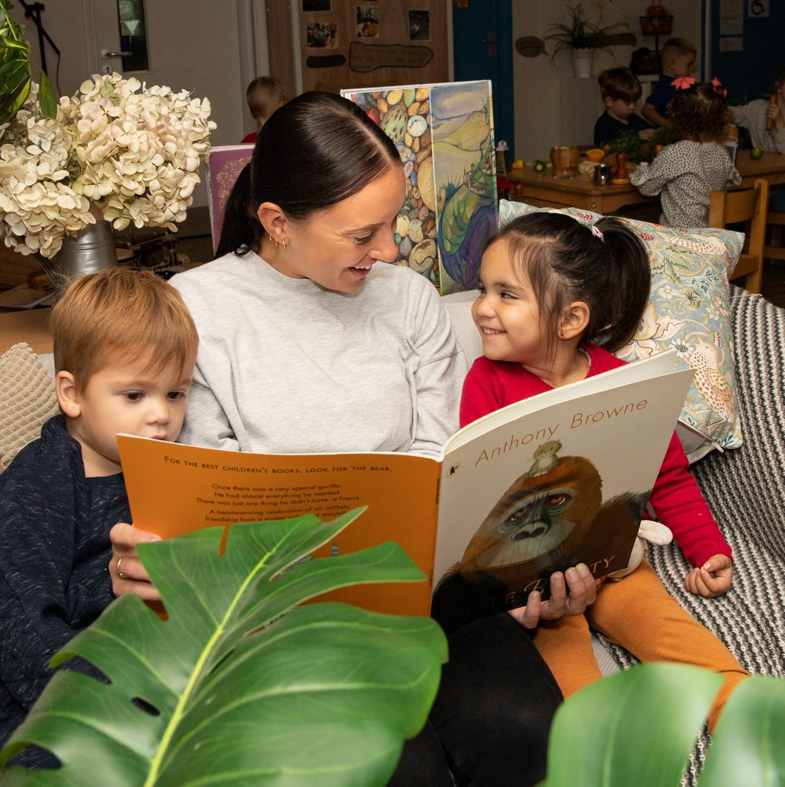
Building Relationships
Tremorfa Nursery School likes to regard itself at the heart of the community and we work closely with all stakeholders to ensure that an atmosphere of mutual respect and trust is achieved.​ Building genuine relationships is crucial to ensure the team around the child support and challenge effectively. We pride ourselves on having trusted relationships with all stakeholders. Governors are an integral part of the school and are involved in all decision making and act as a critical friend. ​
We work in a ‘Key Person Approach’ to ensure that all
children form an attachment with a consistent, familiar
person who is accessible and available as a point of contact
for the child and parents or carers. A key person is a named
member of staff with responsibilities for a small group of
children. They will build strong, nurturing relationships with
the children in their groups to ensure that they feel safe and
cared for. In TNS, we call these groups ‘POD groups’. This
key relationship means that every child receives a bespoke
package that is individual to them. Consideration is given to
their previous lived, and ongoing, experiences. Children’s
strengths are built upon with planned, relevant experiences
to enhance their learning.

Slide 13
Building Relationships (cont.)
At TNS we believe that ‘professional love’ must be embedded in the culture and ethos of our setting, demonstrating a commitment to meeting the emotional needs of children (Dr Jools Page). Warm and sensitive responses to children’s emotions are key to their well-being. Young children may need physical comfort or a hug when they have hurt themselves or upset and it is important that this is provided for them when they are away from home.
Parental involvement is a vital part of our work; we value parents as the child’s first educator and allow time and space for parents/carers to share details of each child’s experiences, skills and abilities. We hope that parents/carers feel comfortable enough to come and help within the school in a number of ways. Their involvement is welcomed and celebrated.​
​Our team of practitioners work closely together and we respectfully challenge and work collaboratively to meet the needs of all learners. We constantly engage in professional dialogue and self-reflect in order to be ever evolving.

Slide 14
Starting school
Tremorfa Nursery School values the importance of transition for all children. Ensuring these transitions are as smooth as possible is fundamental.
Link Up
Before starting school you will be invited to join a ‘Link-up’ group. This is an informal group where the focus is on developing relationships between nursery and new children. Attending these sessions support children in transitioning to nursery.
Meet the Teacher
Each child is placed in a small family group called POD groups. Each POD is overseen by one of the teachers who will invite you in the day before your child will start nursery for a ‘Meet the teacher’ meeting. This meeting is an opportunity for you to chat with your child's teacher and for us to get to know your child and family so that we can ensure that we are able to support your child as well as possible during their time in nursery.
Settling in
On your child's first day we will ask that you leave them for an hour only. Your child teacher will let you know on a day by day basis how long to leave your child during this settling in period depending on how they have been each day. Please be prepared to return early to collect your child if needs be. It is vital that we ensure that each child has a positive experience when settling in.
Toileting
All children are at different stages of toileting journey. We will chat to you about where your child is at with toileting during the ‘Meet the Teacher ‘ meeting.

Slide 15
POD Groups
POD stands for ‘Plan of the Day’ and supports children to work in a ‘plan-do-review’ cycle. POD times happen right at the beginning and end of every nursery session and we include all children in different ways. This is a special time for children to sit with their key person/POD leader and others in their group every day. We create a welcoming, inclusive and developmentally appropriate environment. Our aim is to ensure that all children feel safe, secure and develop a sense of belonging to a group.
During POD time, staff may plan short games/ activities that enable them to check what children know, or maybe introduce something new, but the main focus of POD time is about engaging children in conversation, promoting early language within a small, familiar group context. Children are encouraged to plan their play – remembering what they did yesterday, thinking about what they want to do today and who they might like to work or play with. As time goes by, staff will expect children to think more deeply about their plans e.g. the resources they might need and whether or not they need to start by drawing a plan or writing a list. There will also be an expectation that children stick to that plan – within reason.
POD groups reconvene to talk about what children have been doing - this is where we introduce reflection and evaluation. Children are asked about their play and work and encouraged to share it with the group. Over time, we see children analysing their own learning and deciding what they need to do next and why. This is powerful learning.

Slide 16
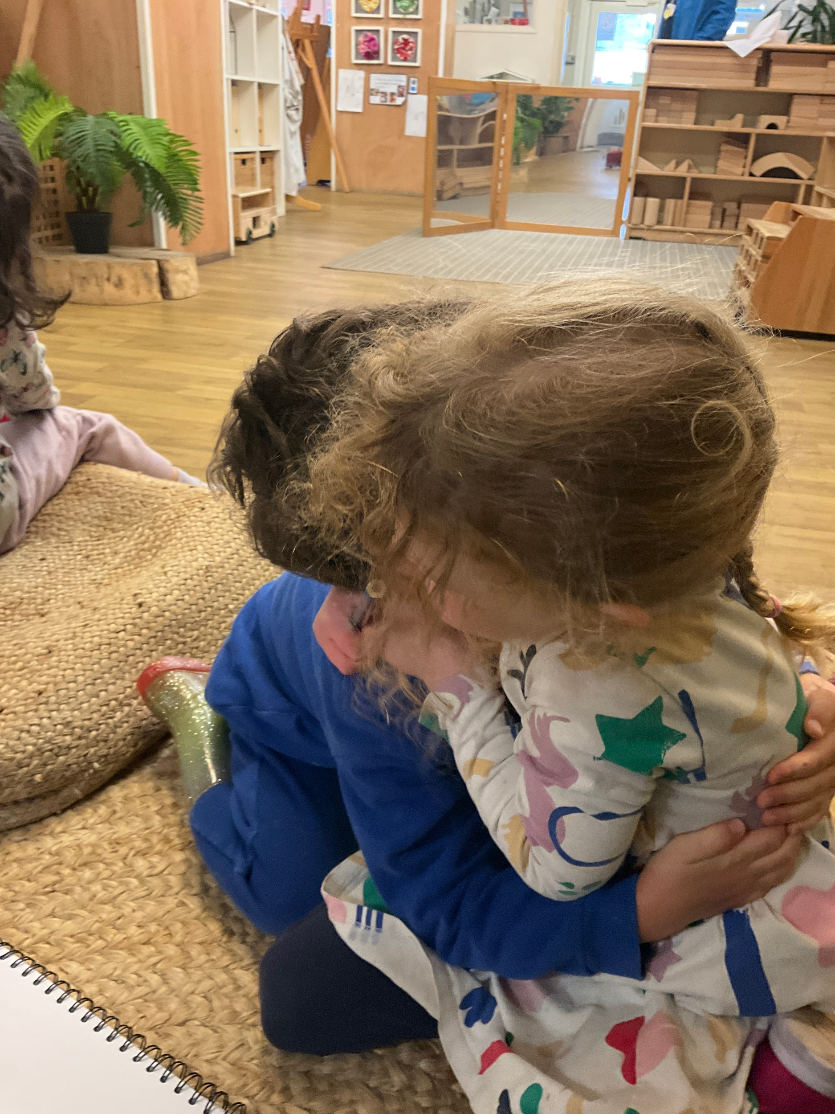
RSE POLICY
What is RSE?
Relationship and Sexuality Education (RSE) encompasses the knowledge, skills, dispositions, and values that will empower learners throughout compulsory education (3-16 years) to -
Support their health and well-being
Develop healthy, safe and fulfilling relationships of all kinds, including those with family and friends and, as they get older, romantic and sexual relationships
Navigate and make sense of how relationships, sex, gender, and sexuality shape their own and other peoples’ identities and lives
Understand and support their rights and those of others to enjoy equitable, safe, healthy and fulfilling relationships throughout their lives and to advocate for these.

Slide 17
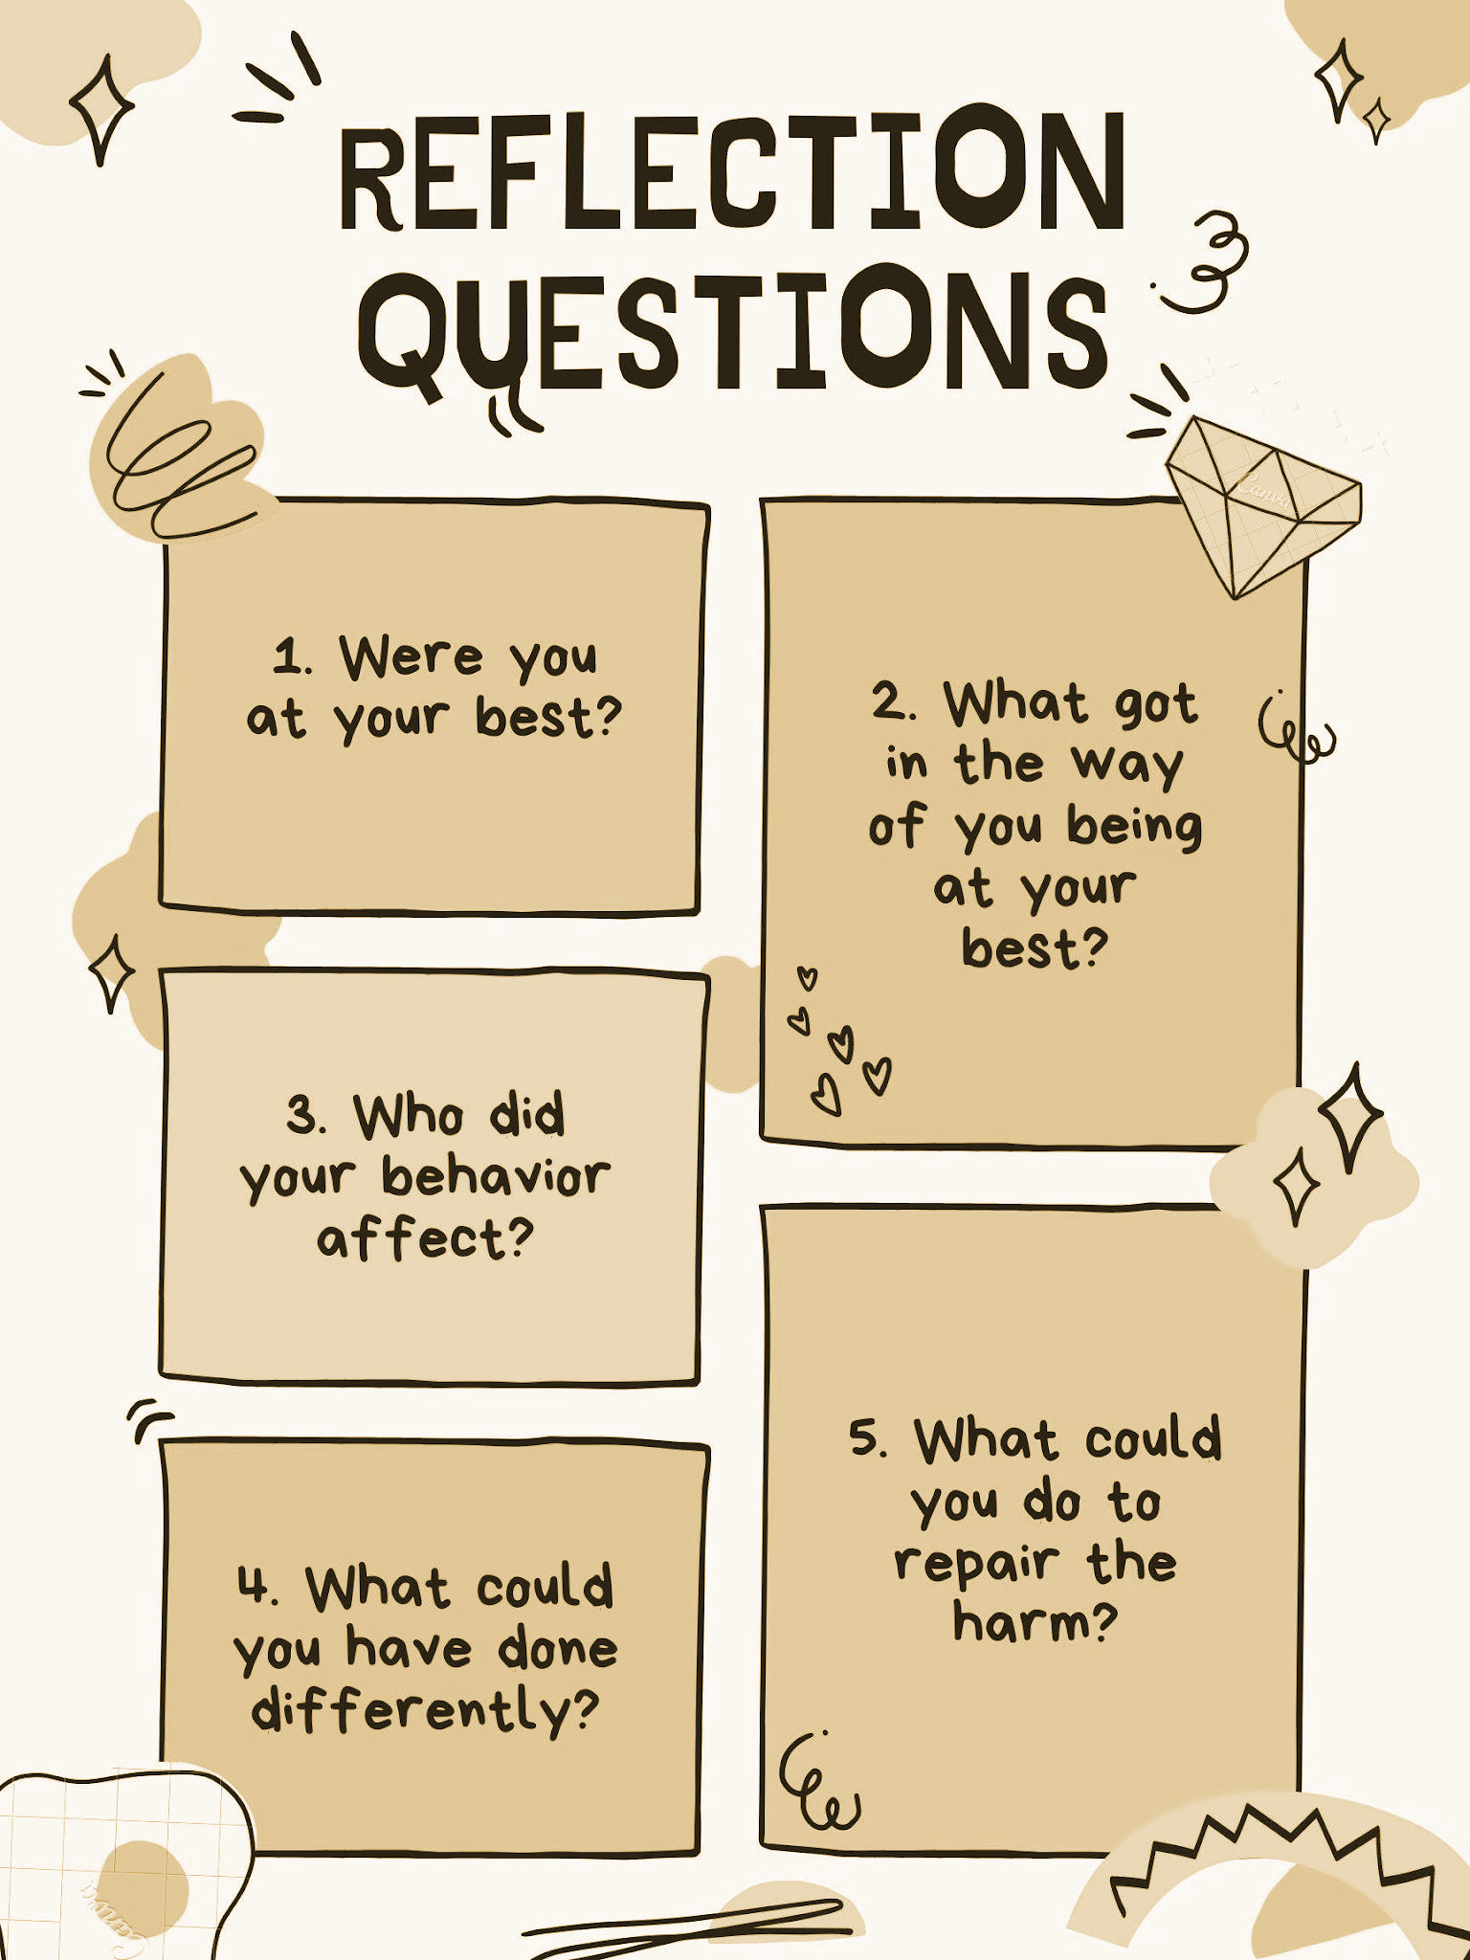
Restorative Approach
We use the term restorative practice to describe behaviours, interactions and approaches which help to build and maintain positive, healthy relationships, resolve difficulties and repair harm where there has been conflict. We use restorative conversations with children, families, and among staff members when appropriate.
We use the following questions to structure conversations with adults:
What happened?
What were you thinking at the time?
What have you thought about since?
Who was affected by what you have done? In what way?
What do you think you need to do to make things right again?
We use the following questions to structure conversations with children:
What happened?
How are you feeling?
Who is hurt?
How can we make it better?
A Collaboration between Tremorfa Nursery School, Grangetown Nursery School and The Learning Partnership, Wales

Slide 18
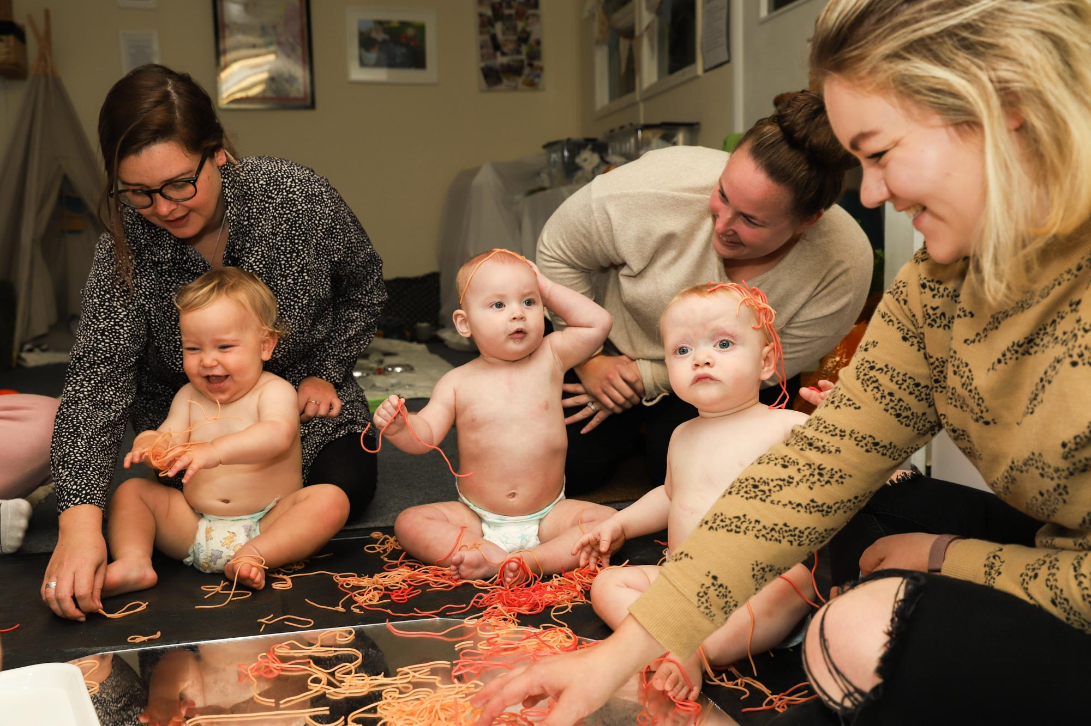
Family Engagement
What we aim to do…
Work closely with families to give children the best home learning environment possible.
Ensure families have the skills, confidence and resources to actively support their children’s learning at home.
Work in a constructive way with families to address any barriers to engagement.
How we do it…
At TNS, we are committed to building relationships with families and taking the time to understand how we can engage them in their children’s learning from the very beginning. We value the strengths, skills and the role that they have in supporting their child’s learning and development is acknowledged and valued.We welcome families into the nursery to share their skills and talents. For example, a parent might come in to cook with a group of children, sharing a recipe from their home. We also run curriculum workshops for parents to become more familiar with Curriculum for Wales and our school curriculum offer.
At TNS, we have a Family Engagement Officer, a designated
member of staff who works closely with families and the
community which the school serves. Our Family Engagement
officer runs weekly groups during school hours. These include a
baby group, toddler group, wellbeing groups and ‘tea and toast’
session.
We aim to raise aspirations for our parents and through the year
we may organise parent workshops and courses based on the
needs and interests of families. Examples of previous workshops
include Paediatric First Aid, Child Development and pottery
classes.

Slide 19
Cynefin
Cynefin is a Welsh term defined by Curriculum for Wales as 'the place where we feel we belong, where the people and landscape around us are familiar, and the sights and sounds are reassuringly recognisable.’
Although it can be translated to “habitat” in English, cynefin is not just the area in which we live. It is often used to describe the relationship between people and the natural world, and how our connection to our surroundings can shape our sense of identity and well-being.
At TNS, we recognise that Curriculum for Wales places emphasis on teaching cynefin, and so it forms a significant part of the school’s bespoke curriculum. As a school we feel this is so important as it allows us to personalise the curriculum for our children so that they can build meaningful connections with their local environment. We provide a wealth of opportunities for our children to explore to explore the natural world, locally and across Wales which will nurture a sense of place and well-being. Our children have the opportunity to explore the history and beauty of our local beaches through Beach School.

Slide 20
Curriculum
At Tremorfa Nursery School, we know that high-quality early education is essential to children’s development. We aspire to create in children positive dispositions towards learning which, if nurtured, will last a lifetime and provide the firm foundation which all our children need to support them in realising the Four Purposes of Curriculum for Wales.
Our curriculum is designed to support our children in being and becoming:
Ambitious, capable learners Healthy, confident individuals
Ethical, informed citizens Enterprising, creative contributors
These Four Purposes are underpinned by the Integral Skills which are promoted through a wide range of authentic learning experiences that we offer, helping our children to be and become:
Creative and innovative Planners & organisers
Critical thinkers and problem solvers Personally effective
We observe our children exhibiting these behaviours daily.
They really are capable and competent learners.
Our curriculum recognises and celebrates the individuality of each child and what they bring to the learning experience. We believe that this early period of learning should be unhurried, allowing time, space and freedom for the developing child to consolidate their learning with opportunities to return, revisit, and refine their emerging knowledge and skills. This cyclical approach is essential for progression through the learning journey.

Slide 21
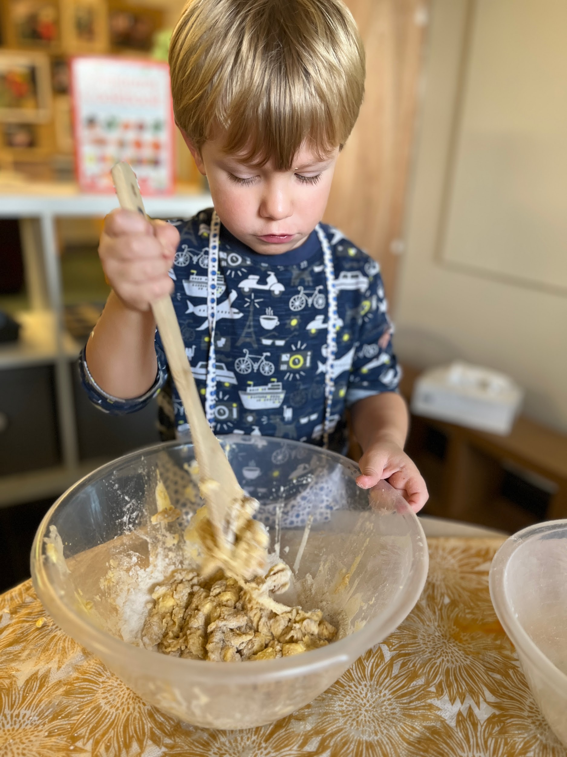
Areas of Learning and Experience
& Cross Curricular Frameworks
The six Areas of Learning & Experience ensure that children have access to a broad and balanced curriculum offer. At TNS we teach them in an holistic way through rich, experiences that are appropriate to the children’s stage of development. When children are cooking, for example, we know that they are developing language, mathematical and scientific skills, as well as having conversations about healthy food choices.
Literacy, Numeracy and Digital Competence are mandatory skills across the whole curriculum, and it is our responsibility to ensure children develop and progress in these areas. When planning rich, holistic learning experiences, we ensure that children have opportunities to apply, develop and extend these skills in meaningful contexts. These skills are practised and consolidated throughout continuous and enhanced provision, as well as during daily routines such as self-registration and family group time.

Slide 22
Religion, Values and Ethics (RVE)
Religion, Values and Ethics (RVE) sits within the Humanities Area of Learning and Experience and is mandatory for all pupils from 3 -16. It has evolved to reflect the ambitions and four purposes of the Curriculum for Wales.
As a maintained Nursery, we follow the Cardiff Agreed Syllabus for RVE in a developmentally appropriate way. Our bespoke curriculum includes provision for RVE in the following ways:
We provide rich contexts for learners to be curious, as well as providing opportunities for learners to reflect, and to experience awe and wonder, in a range of meaningful real-world contexts.
We develop rich contexts for exploring the concepts of identity, belonging, relationships, culture, beliefs, community, cynefin, diversity, and interconnectedness which helps children gain a sense of self.
We provide rich contexts for exploring the concepts of ethics, fairness, responsibilities, authority, rights, values and social action in the form of giving of our time for the benefit of others.

Slide 23
The Three Enablers
We believe that our children’s needs are best met through the interdependent ‘Enablers’:
Enabling Adults
Effective Environments
Engaging Experiences
The Enabling Adult observes, notices and responds sensitively to learners.
Effective Environments, both indoor and outdoor, provide children with authentic experiences and are key to developing a sense of belonging and appreciation of the world around them.
Engaging Experiences promote children’s independence, deep-level involvement and uninterrupted, play-based learning.T
Effective Environments
Enabling Adults
Engaging Experiences

Slide 24
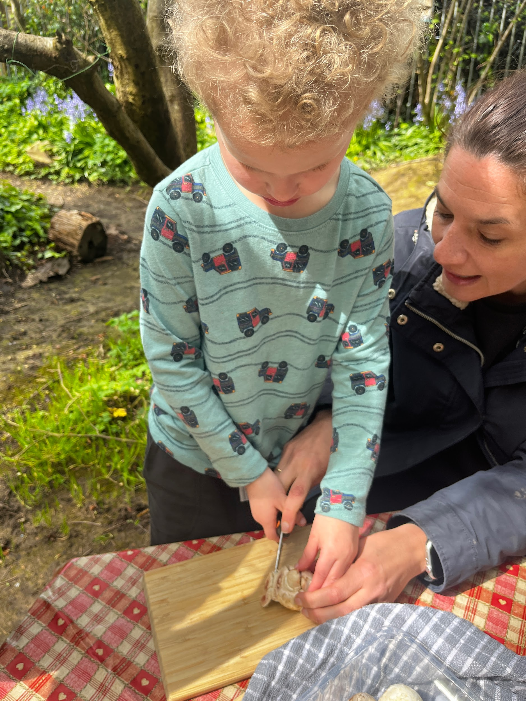
THE THREE ENABLERS
We aim to be Enabling Adults who:
are warm, attentive and responsive to children
are skilful, observant and interested in children and how they develop
use knowledge and understanding of child development to support all children
use knowledge and understanding of how children learn to plan experiences and environments.

Slide 25
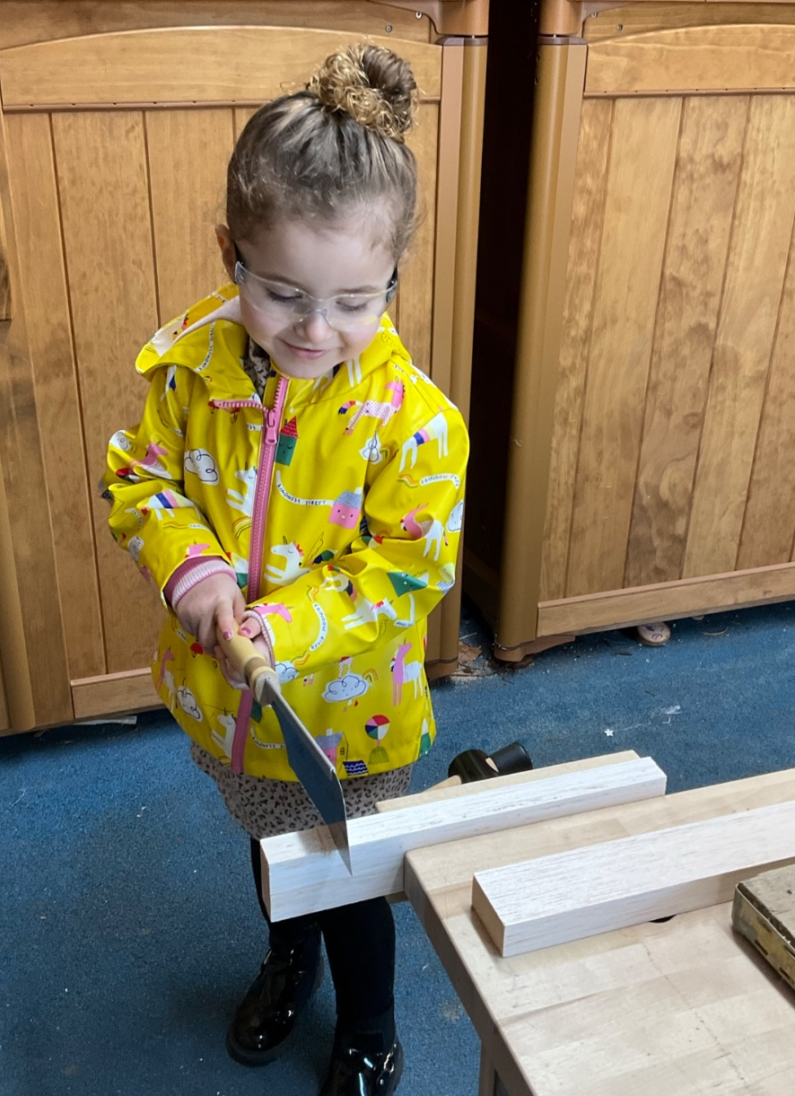
THE THREE ENABLERS
We aim to create Effective Environments that:
provide authentic opportunities for all children to play, explore and discover
create a sense of belonging, ownership and agency
offer appropriate indoor and outdoor experiences
offer safe spaces to encounter appropriate risk and challenge
provide a range of spaces for children to explore what they can do, to problem solve and to better understand the world around them.

Slide 26
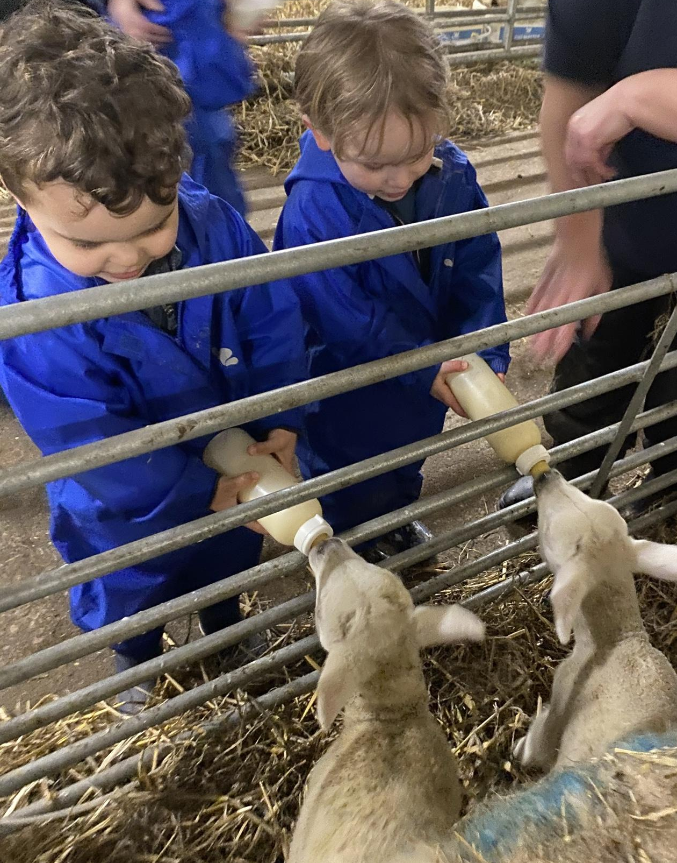
THE THREE ENABLERS
We aim to provide Engaging Experiences that:
build on children’s natural curiosity to explore
support children’s early language development
enable children to develop their physical, social and emotional skills
broaden and deepen children’s thinking and understanding
support creative thinking, problem solving and imagination
develop a sense of cynefin for all children.

Slide 27
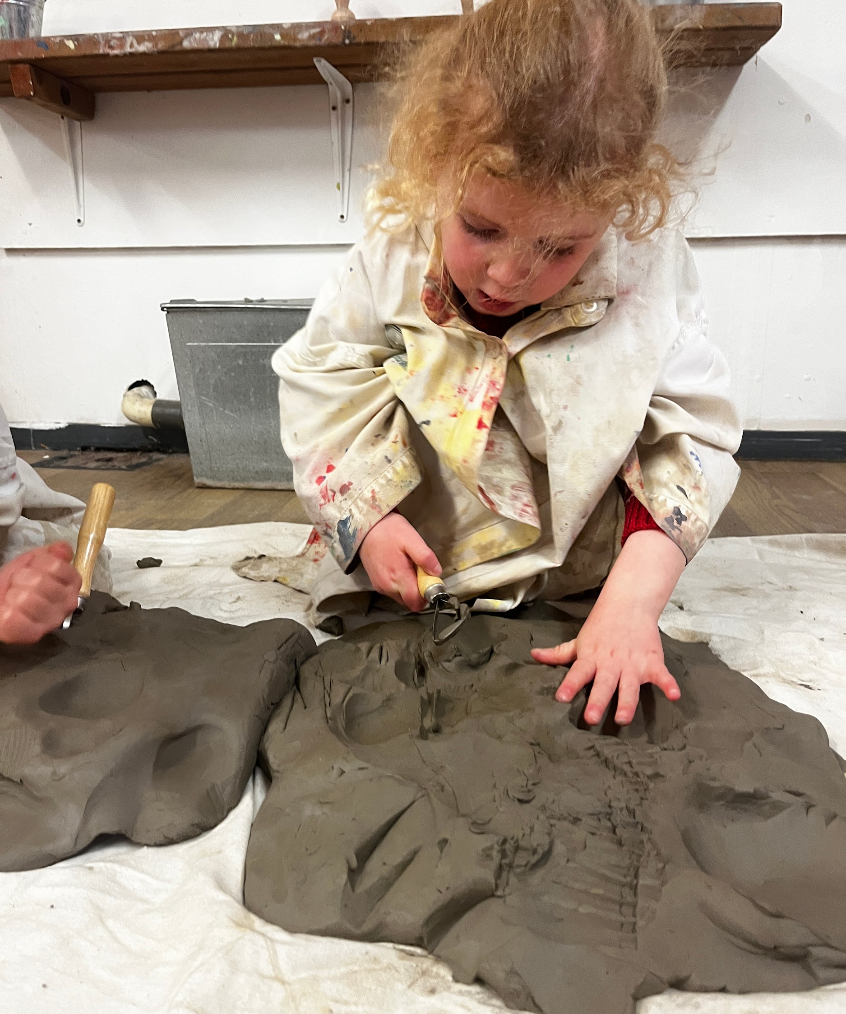
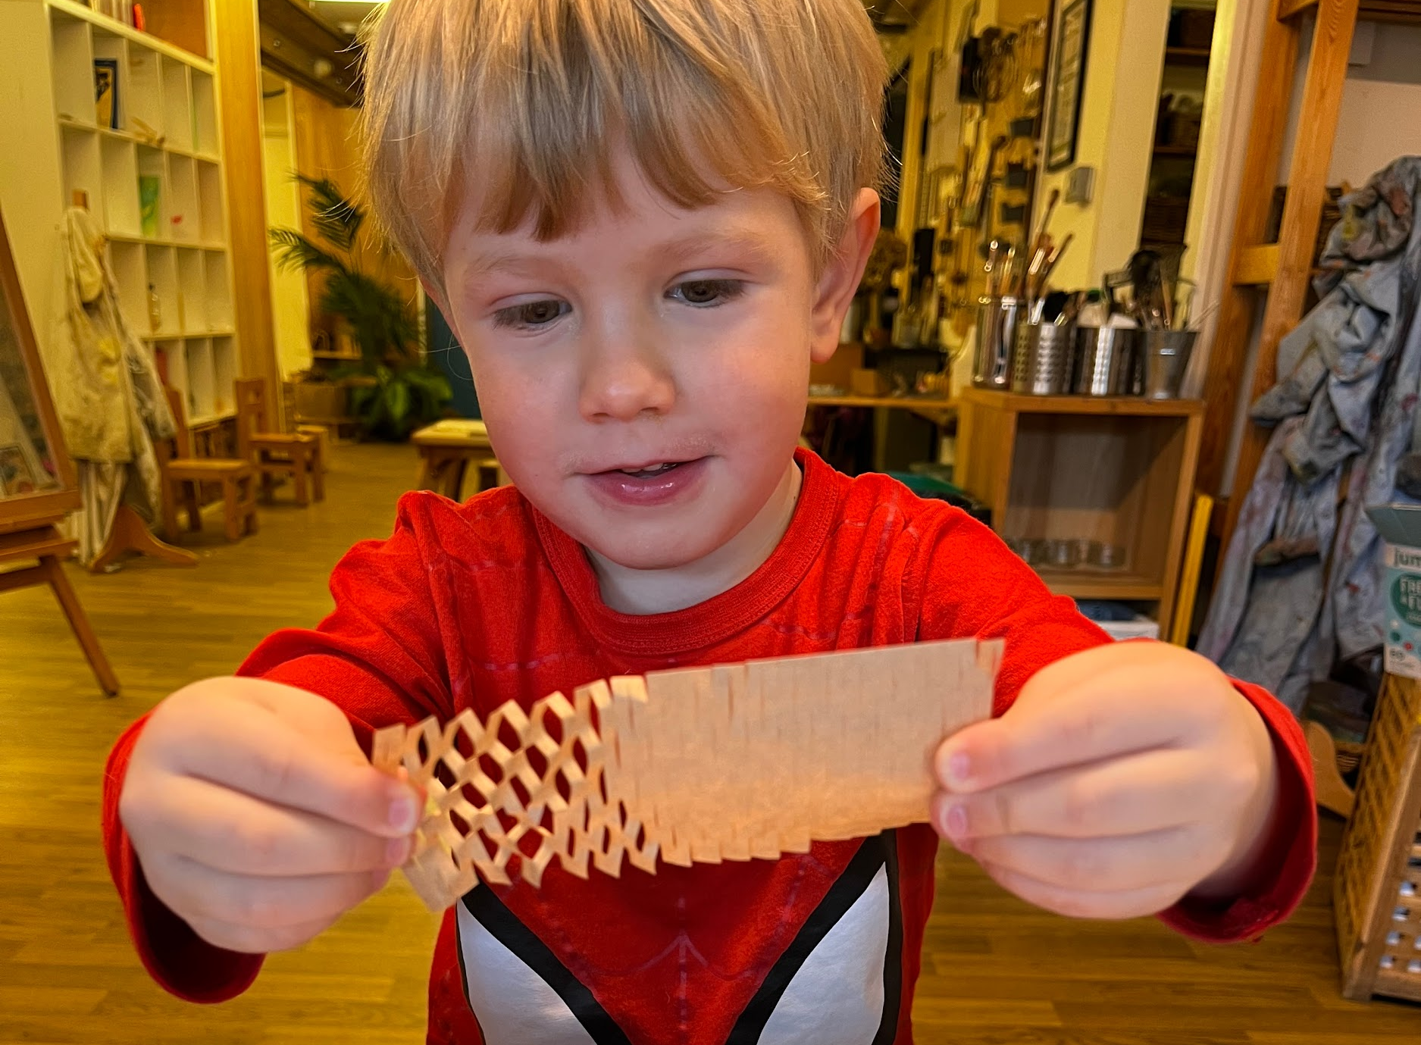
Play Based Learning
What does this mean to us?
At Tremorfa Nursery School, play based learning refers to a holistic approach to learning and development. Through play-based learning, our children learn valuable skills that support their social, physical and cognitive development. By engaging with others, our children learn to make sense of the world around them.
The purpose of play based learning is that it motivates, stimulates and supports our children in their development of skills, concepts, language acquisition & communication skills.
In addition to consolidating learning, it also provides opportunities for our children to develop positive attitudes, demonstrate awareness/use of recent learning, skills and competencies.
‘Play is the highest expression of human development in childhood for it alone is the free expression of what is in the child's soul.’
Friedrich Froebel
1782-1852

Slide 28
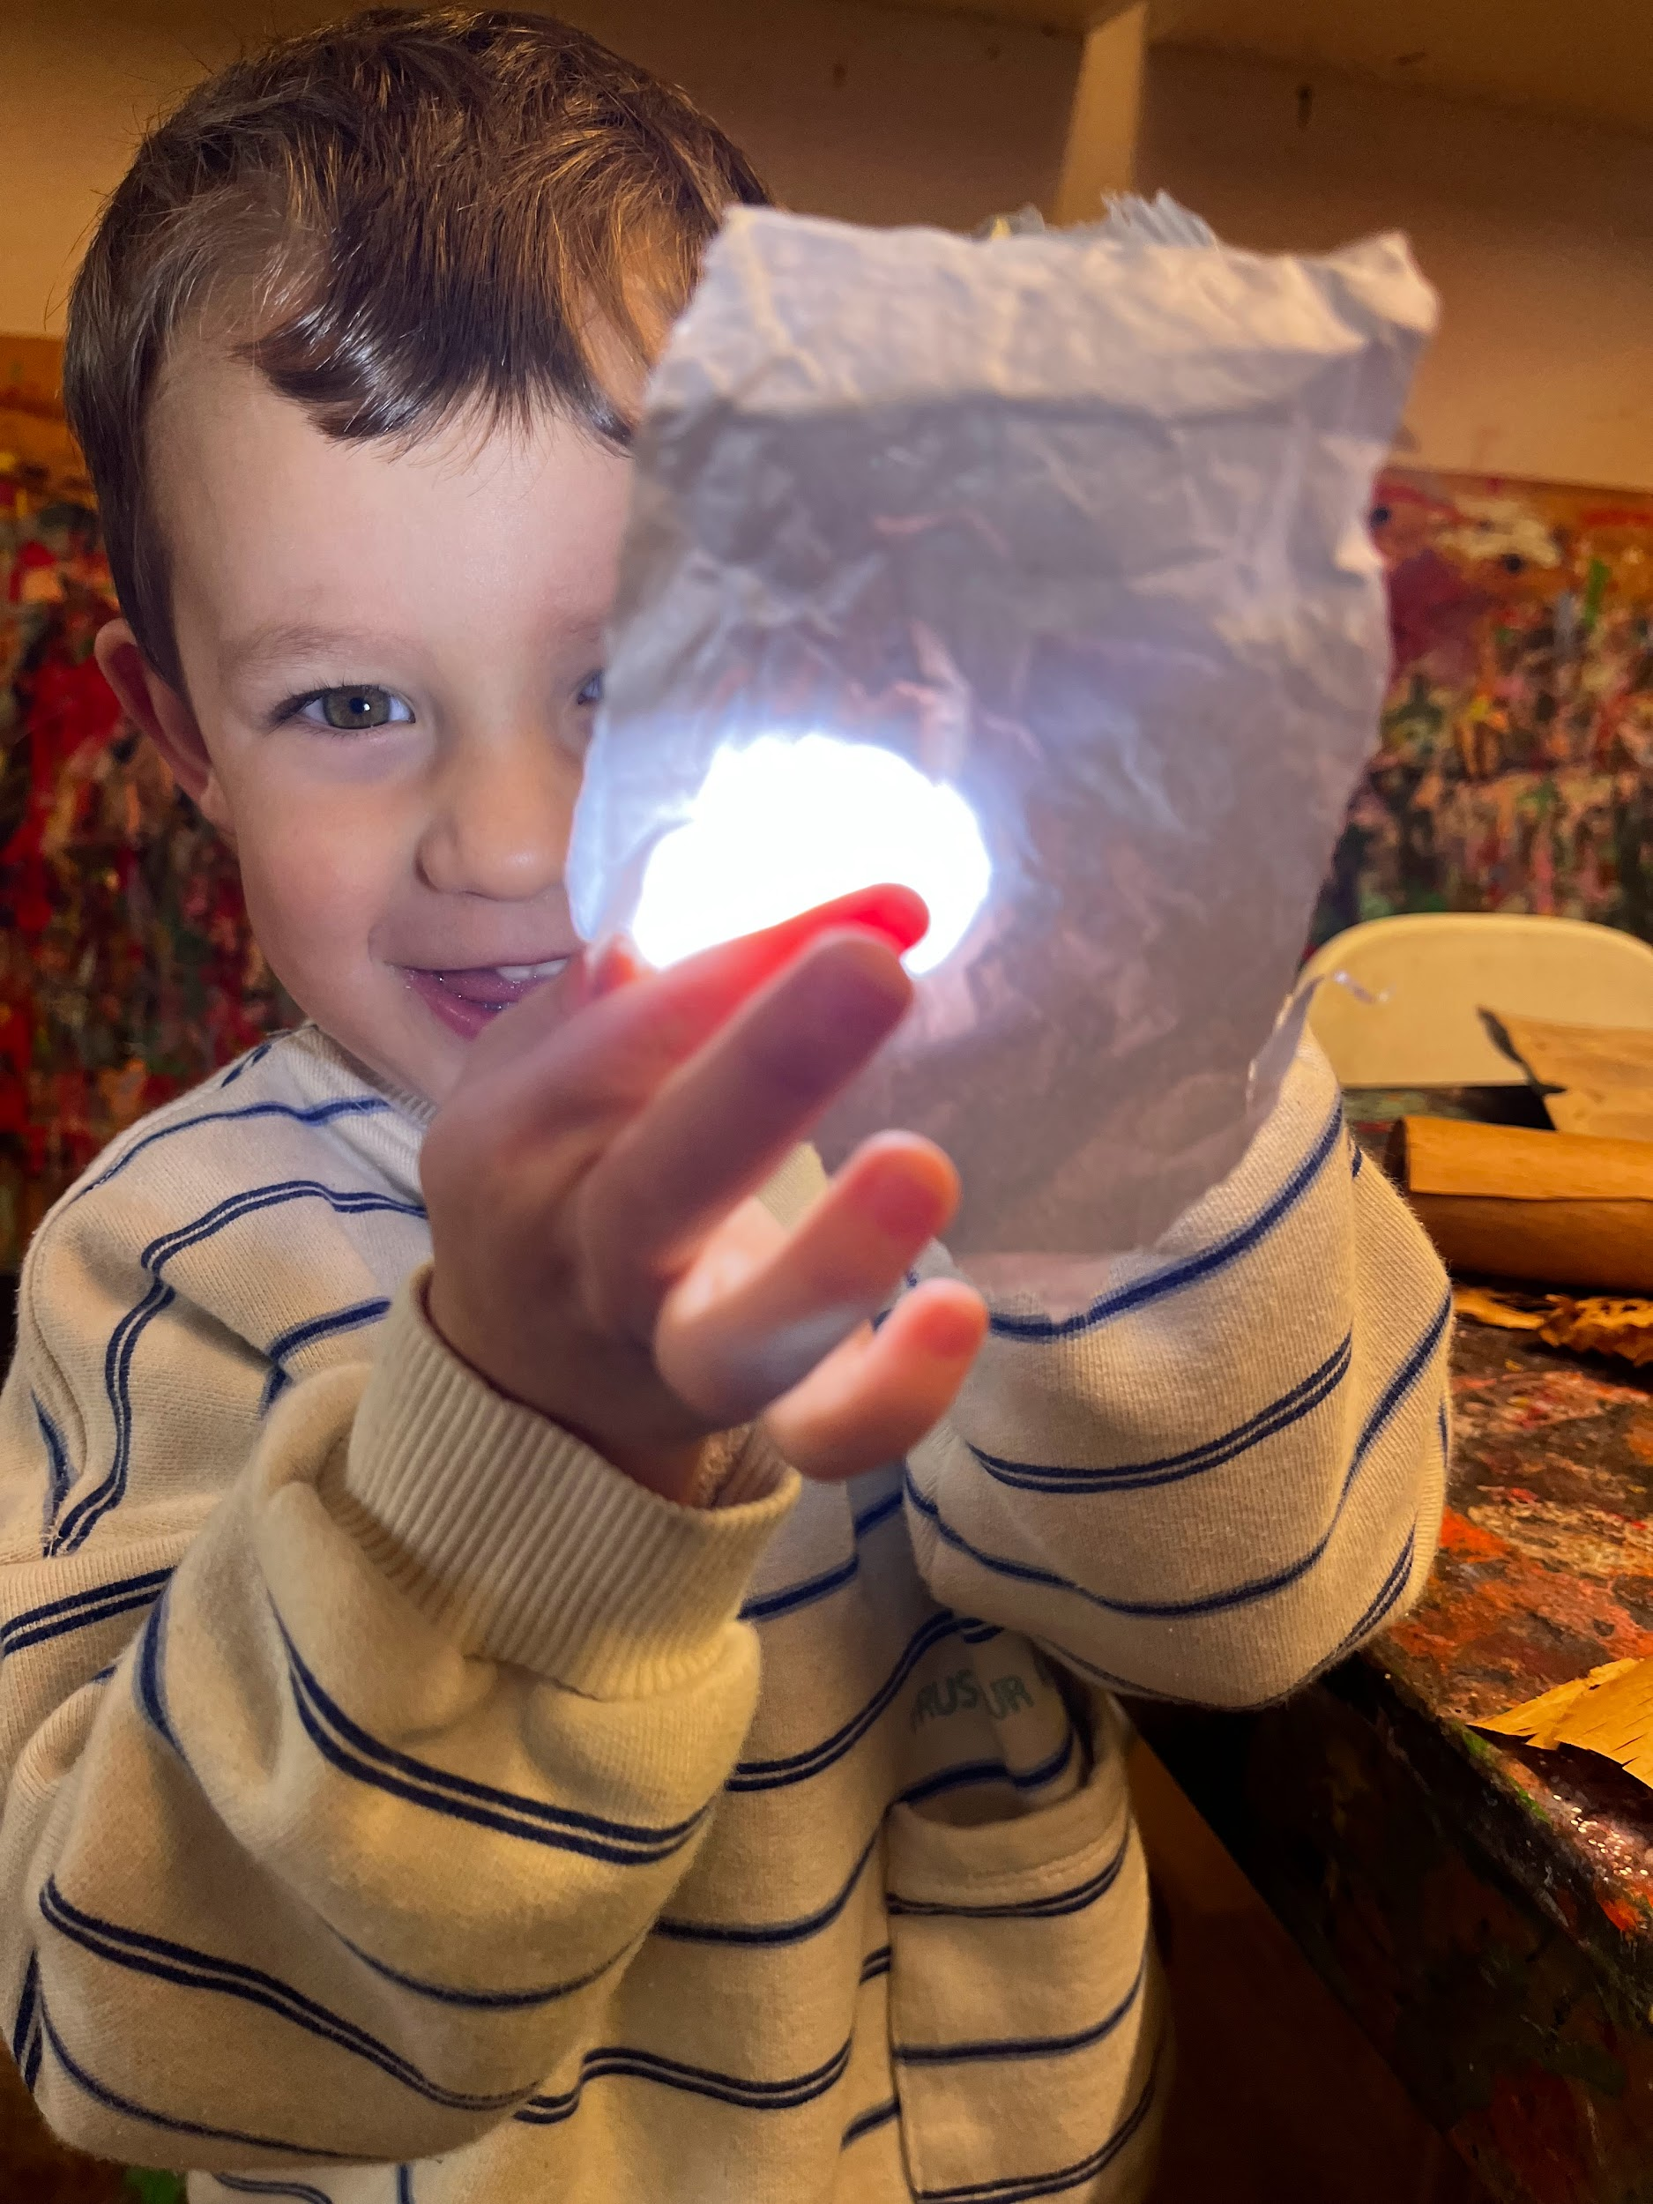
INQUIRY BASED LEARNING
Inquiry based learning is a pedagogical approach, which aims to engage our children through exploration and high-level questioning and by making real-world connections.
Inquiry based learning is an approach to learning that consciously positions our children as active participants in a process of investigation. We encourage them to engage in problem-solving and experiential, authentic learning.
Inquiry based learning emphasises the construction of conceptual understandings together with the development of knowledge, skills, and learning dispositions. Questions, both adult and child initiated, help to drive the learning.
Inquiry is a ‘stance’ that sees children as competent, capable learners, and adults as skilful facilitators and co-researchers. Young children are natural inquirers, they are curious about the world around them and how the world works. As adults, we need to model, capture and celebrate curiosity.

Slide 29
Inclusive Practice
Additional Learning Needs
We are committed to actively reflecting on and developing our inclusive pedagogy and practice, recognising that inclusion is an ongoing and ever evolving process. Inclusion and Inclusive practice form a cornerstone of the Curriculum for Wales and ALN code of practice (2021).
All children belong to a POD group with a key person and have full access to our environment and inclusive provision. We may need to make thoughtful changes and adaptations as necessary, depending on the needs of the child. We aim to meet the learning needs of all children through high quality teaching and learning provision. We use a total communication approach with all children in the setting which includes Makaton, visual timetables and traffic lights.
The term ‘Adverse Childhood Experiences’ (ACEs) refers to traumatic events a child may experience before the age of 18. At TNS, we recognise that exposure to adversity and trauma, over the short or longer term, can have a detrimental effect on children’s capacity to learn and develop. Research suggests that good-quality settings can reduce the impact of adversity on children. We actively seek to better our knowledge of supporting children with varying needs within our school. We use the Thrive Approach and ELSA where appropriate to meet the social and emotional needs of our children.

Slide 30
Inclusive Practice
Equity, Equality & Diversity
At TNS, we are deeply committed to creating an environment that embraces difference and ensures that everyone within the school is seen, heard, accepted, respected and valued. We constantly strive to draw upon and celebrate our wonderfully diverse school community, embracing difference and the uniqueness and individuality that each child and their family bring. We aim to be supportive of different groups of individuals, including people of different races, ethnicities, religions, abilities, genders, and sexual orientations.
We work proactively to reflect on and break down barriers to learning by being fair and transparent, enabling equitable opportunities. At TNS, we recognise that children come from diverse backgrounds, circumstances and life experiences. We want to foster a sense of belonging through unequivocal support for every child and their family.
We prioritise building deep and meaningful relationships with our families from the very beginning. It is crucial that we have an in-depth understanding of all our families - their lives and cultures, so that we can have meaningful conversations with children during our POD times. This gives children the opportunity to share their special times with the people in the setting who are closest to them.

Slide 31

Rights Respecting Schools
Rights Respecting Schools is an initiative run by UNICEF UK, which encourages schools to place the UN convention on the Rights of the Child (CRC) at the heart of its ethos and curriculum. UNICEF works with schools in the UK to create safe and inspiring places to learn, where children are respected, their talents nurtured and they are able to thrive.
The Rights Respecting Schools Award embeds these values in daily school life and gives children the best chance to lead happy, healthy lives and to be responsible, active citizens.
There are 4 key areas of impact for children at a Rights Respecting School; wellbeing, participation, relationships and self-esteem. The difference that a Rights Respecting School makes goes beyond the school gates, making a positive impact on the whole community.
At TNS, we have recently achieved The Gold Rights Respecting Schools Award. This is the highest level of the Award. It is granted by Unicef UK to schools that have fully embedded children’s rights throughout the school in its policies, practice and ethos.
This means that we teach children about their rights, through their rights and for their rights. Rights are also an important concept throughout the Humanities AOLE.

Slide 32
The Rhythm of the Year
Our ‘Rhythm of the Year’ planning is a way to support and guide us about the learning that may happen each year. The visual and physical experiences of the changes in seasons are symbolic to children and we pay close attention to the natural rhythm around us. Additional festivals may be celebrated depending on the cultures and traditions of children on roll. All children celebrate their fourth birthday during their time with us and we want to make this a really special day for them.
Each term is planned at the beginning of the year to decide when the following will happen: core books and rhymes, planned events/visits, specific occupations or projects, and involvement of parents. These may change slightly each year depending on the needs and interests of the children and families. The intention is that there is a sequence of events that sets out what we want children to learn and when we want them to learn it, as well as how it will be taught. ‘Next steps’ are addressed in the moment or through planning to specifically address gaps.
Core books are a carefully selected range of books. They are chosen for their clear story lines, strong language patterns, repetitive sequences and supportive visual images. By the time our children leave nursery, we want them to build up a repertoire of well-known stories.

Slide 33
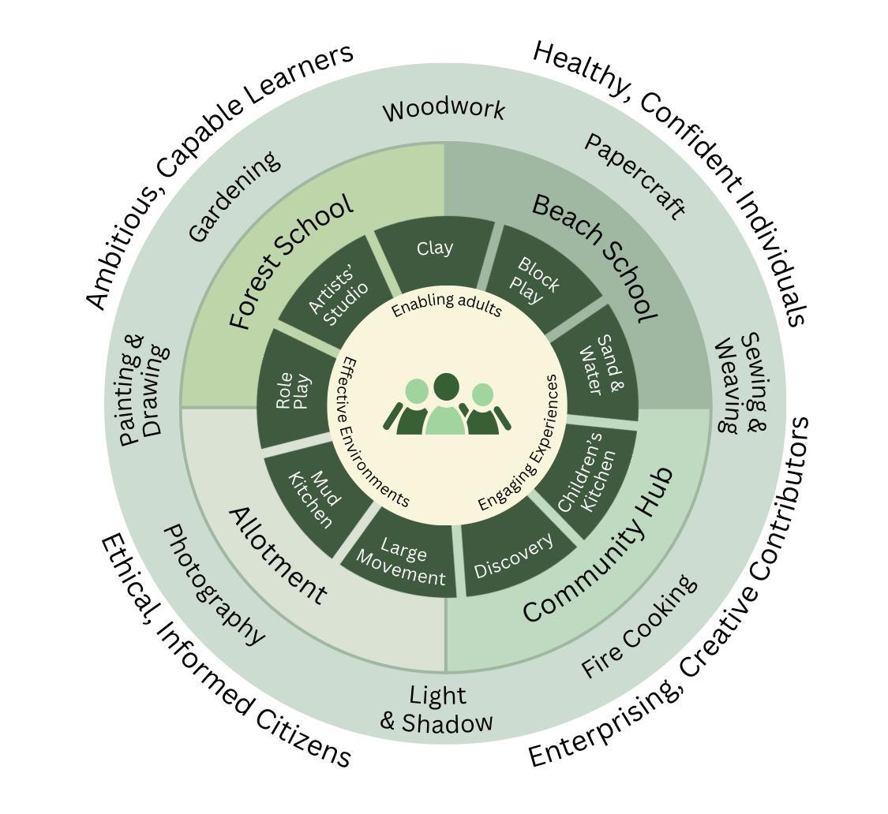
The Rhythm of the Year
KEY
Family Groups
Continuous Provision
Core Experiences
Special Projects

Slide 34
THE RHYTHM OF THE YEAR
Term | Core Books | Core Songs/ Rhymes | Exploring the Natural World | Projects/ Occupations | Possible Mini Trips
Autumn September - December | The Little Red Hen Owl Babies The Gingerbread Man | Incy Wincy Spider Squirrel, squirrel Yn Yr Hydref Christmas Jingles | Harvesting Vegetables Planting Bulbs Investigation of Leaves, Seeds and Berries | Fire Cooking Clay (Whole Body) Woodwork Painting and Drawing | Autumn Walk Sherman Theatre Pick a Christmas Tree
Spring January - March | We’re Going on a Bear Hunt Jaspers Beanstalk | Two Little Dickie Birds Aderyn Melyn Sut Mae’r Tywydd Heddiw? | Birdwatching Ice/ Frost Investigations Chick Hatching & Tadpoles Composting | Cookery Sewing and Weaving Papercraft Gardening | Roath Park/ Cosmeston Farm Visit Castle Visit
Summer April – July | Jack and the Beanstalk The Hungry Caterpillar | 5 Little Peas Tiny Caterpillar Dig My Garden | Observation of Caterpillars/ Butterfly Release Insects & Pollinators | Woodwork Light & Shadow Photography Clay | Splash Pad Mountain View Ranch Strawberry Picking

Slide 35
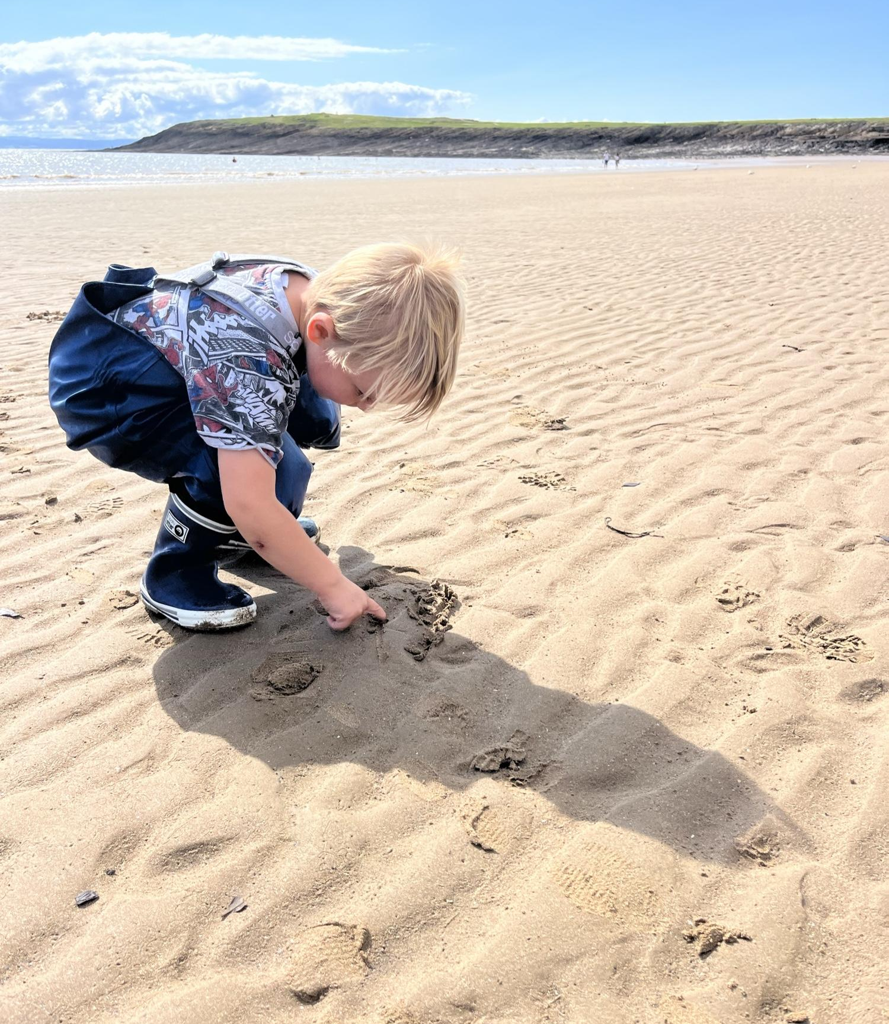
Core Experiences
These are the core offsite experiences offered to every child in Nursery. Each of these experiences will be planned and initiated by an adult however, within the sessions there will be an element of freedom with guidance. In particular, Forest School and Beach School sessions will be lead by the children in a safe and developmentally appropriate way. The adult leader will always have a planned task ‘up their sleeve’ but usually the children take the learning in far more exciting direction.
Our core experiences have their own handbooks, policies and guidance and are led by trained or qualified members of staff.
Wellbeing is the foundation of our practice and through recognising the social, emotional and physical needs of our children, we provide the guidance and facilitation for our time in nature.

Slide 36
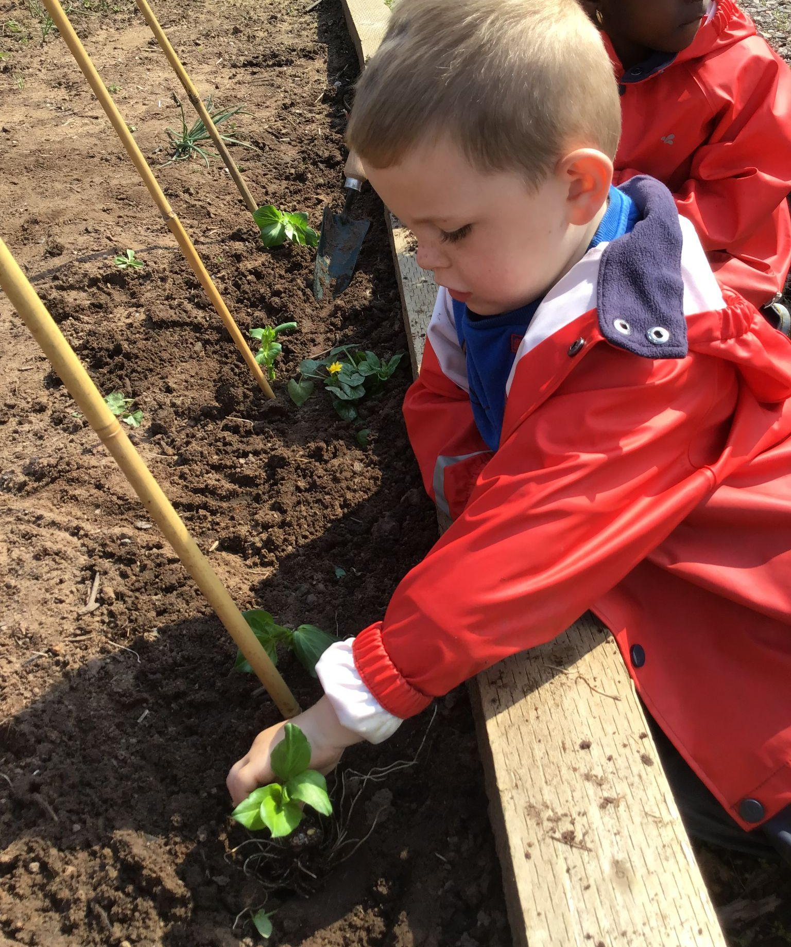
The Allotment
Our Allotment is situated in Pengam Pavillion Allotment Gardens and is a 10 minute walk from the nursery. We are currently working in collaboration with groups of parents and the allotment committee to create an off-site space, so that children can experience growing and harvesting through the seasons. Some key experiences for children may include planting a seed in the spring or harvesting pumpkins in the autumn. We want to ensure that children see the process of planting through so regular visits to the allotment are essential.
Our allotment is a ‘work in progress’. We have created short, medium and long term action plans for the allotment. In the future, our environment will include raised beds for planting, sensory gardens, fruit trees and bushes, a compost heap, a water butt, a log circle, bird feeders and a laboratory for investigation. Our aim is to take POD groups with their key person for a number of regular sessions and for this space to become part of our curriculum offer when the environment is ready to support learning.

Slide 37
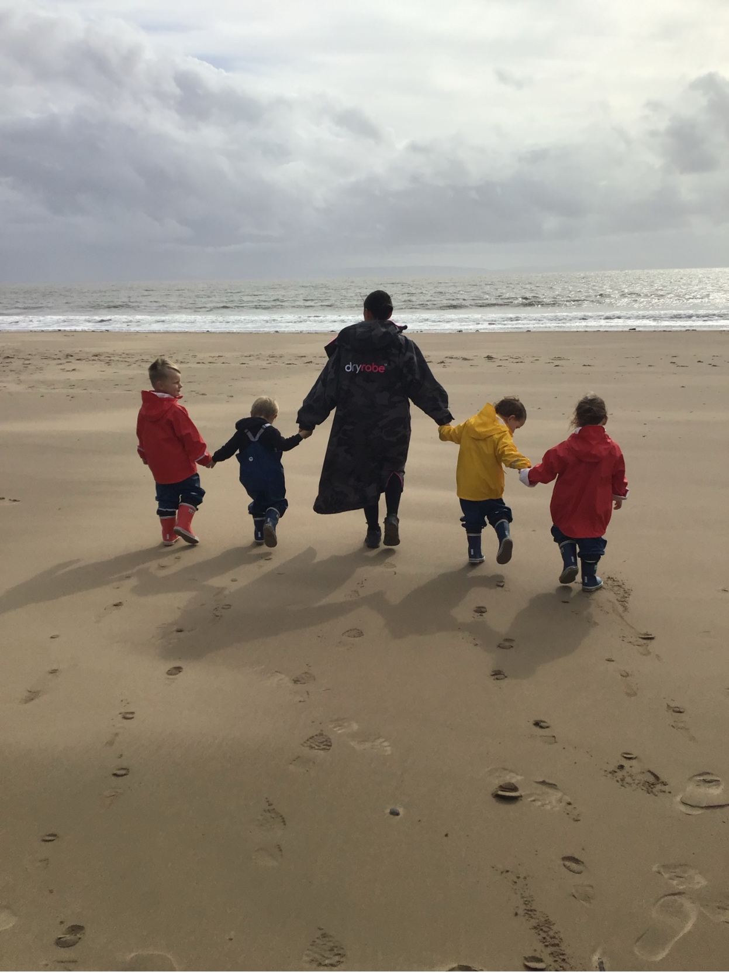
Beach School
Every child will have the opportunity to participate in ‘Beach School’ during their time in nursery. They will be involved in exploring the beach environment in and around Cardiff and Barry area. Beach School gives children a chance to explore and investigate the marine environment whilst developing many key skills . You will find out more when it is your child's turn to attend the Beach School sessions.

Slide 38
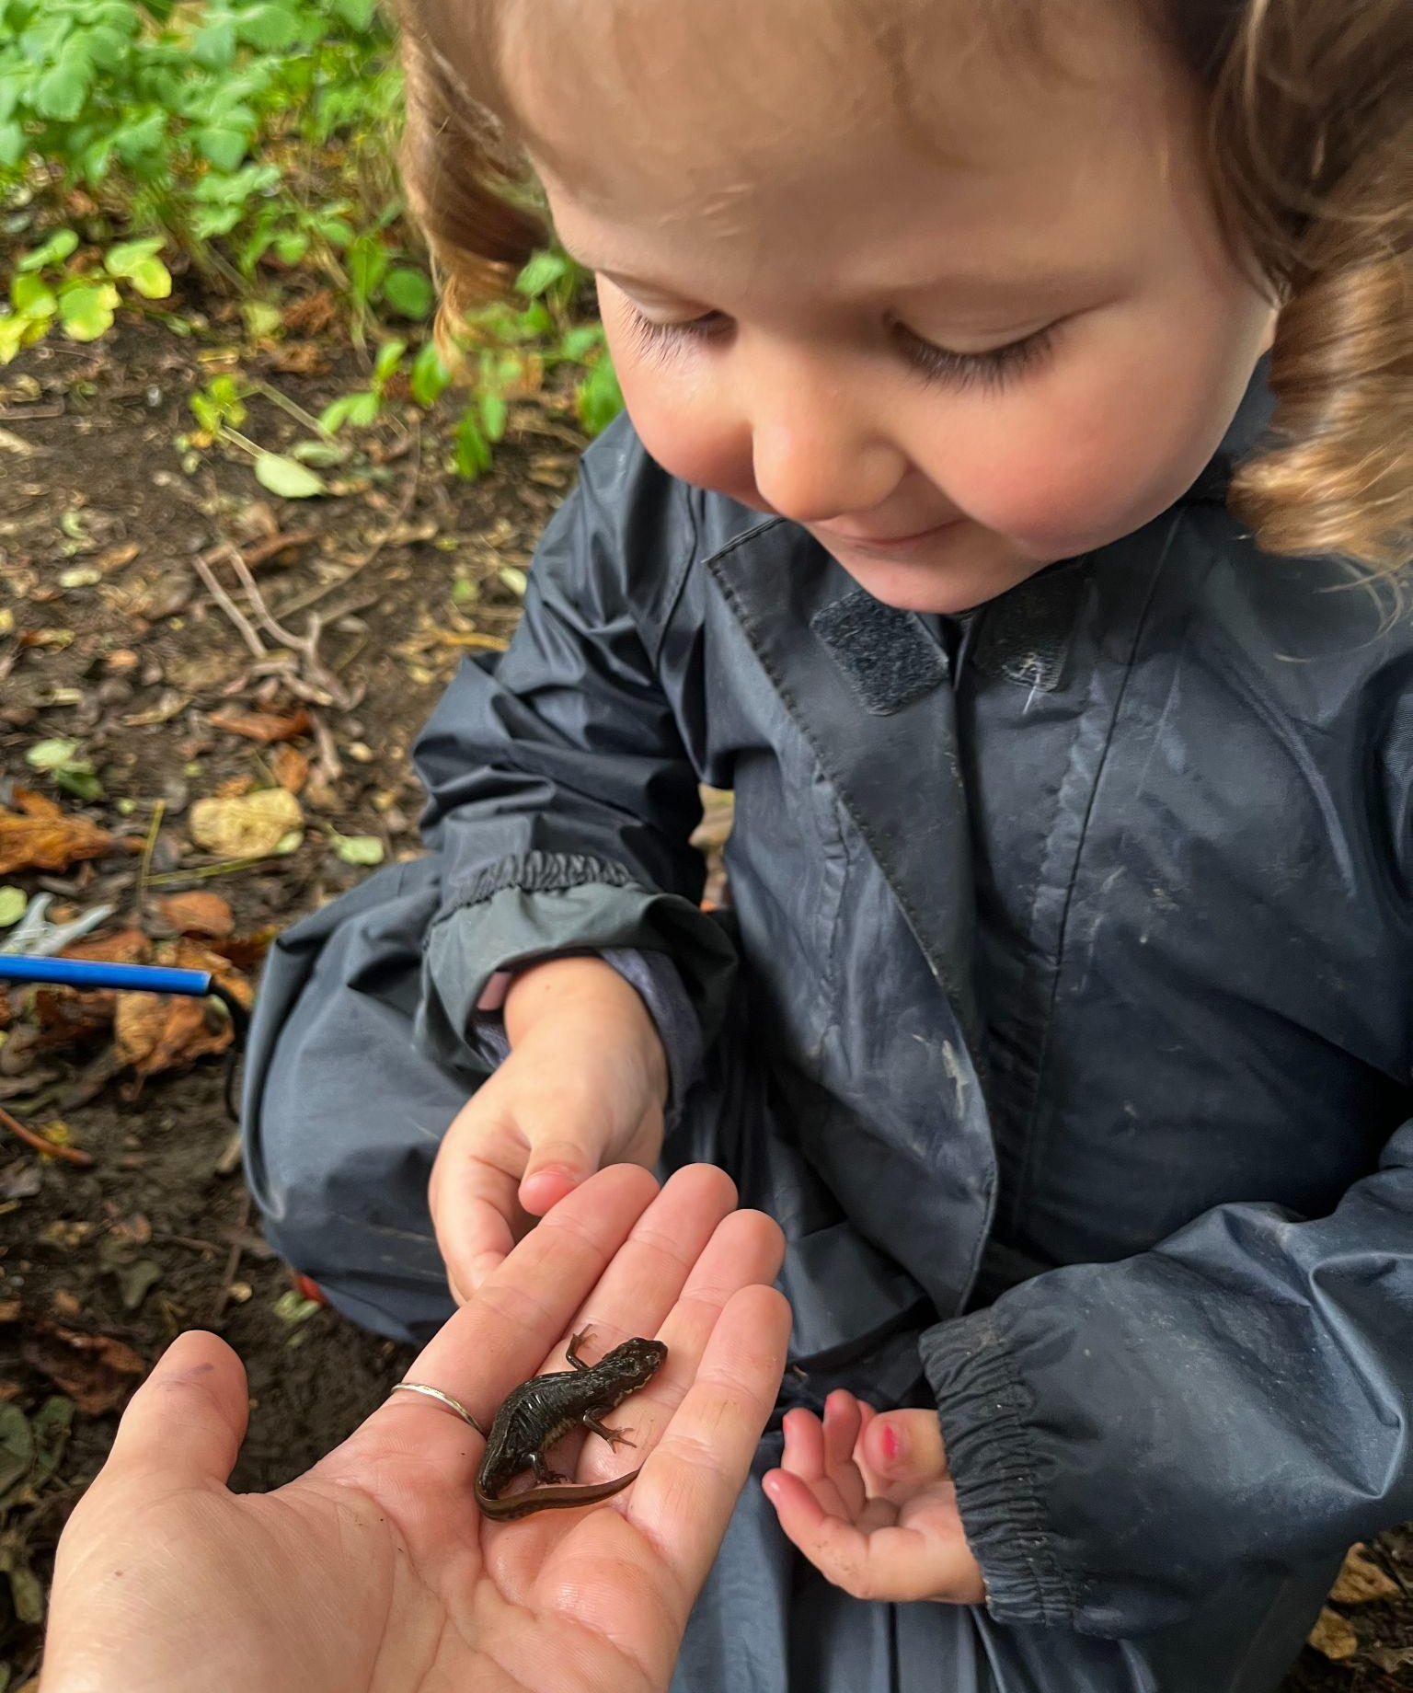
Forest School
Every child will have the opportunity to participate in ‘Forest School’ right here at our
nursery. They will be involved in exploring the ‘woodland’ environment, searching for bugs, frogs etc, working with natural materials, toasting
marshmallows and much, much more! This approach encourages children to work as a team and is a great way to build confidence and self esteem as well as developing all other areas of learning. You will find out more, and how you can
become involved when your child starts nursery.

Slide 39
Special Projects
At TNS, we believe that following children's interests and fascinations leads to deeper levels of thinking, learning and involvement. Our special projects provide meaningful learning opportunities in an authentic, emergent way. They may start from an interest a child has brought from home, for example ‘space’, or they may be brought up by careful exploration of children’s interests, carried out by staff observations. For example, young children may be interested in sensory play, changes in nature, colours or differences between them and other children. Projects may last for a few weeks or longer and only finish when they have come to a natural end or children’s interests change.
We recognise that not all projects can be brought about by the children and so we have planned projects throughout the year that we will focus on. Some of these projects are inspired by the Reggio Emilia approach and staff visits to the ateliers in the Loris Maluguzzi centre.
We are also inspired by the work of Froebel and provide opportunities for the children to experience woodwork, block play, gardening, cooking, clay, sewing and weaving. These experiences, called occupations, are planned for on a regular basis to ensure that every child has access to them. Each occupation has its own stages of development/ competence which can support the practitioner to understand where children are at in their learning and enable them to facilitate next steps.

Slide 40
The Rhythm of the Day
The provision that is available for children to access daily includes elements that are both planned and spontaneous. For the majority of their time in nursery, children engage in self-directed play.
Routines, rhythms and rituals make up the children's nursery day and provide children with a sense of security and belonging. Our rhythm of the day supports children to develop self-regulation skills, self-esteem and confidence by providing opportunities for children to experience success in what they do.
There are set ‘areas’ of provision that are available daily so that children can become familiar with them and how to use them, allowing them to plan their play. Although the areas stay the same, resources may vary in order to engage, motivate and teach. Most resources are made of natural or recycled materials and are open-ended. This means that these resources don’t necessarily have a fixed purpose and can be used with endless possibilities. For example, stones, shells, fir cones and conkers can be used for counting and sorting, to represent food or an animal.
Children’s snack is available throughout the session and children choose when they want to access and how much/ how little they want to eat. Research shows that young children are believed to have an innate capacity to self-regulate their food intake. We want to develop self-regulation in children and give them the freedom to listen to their own bodies.

Slide 41
THE RHYTHM OF THE DAY
PLAN 9.00-9.20am/ 12.45-1.05pm | Say Hello POD Groups | Welcome & Self-registration Conversation, reflection on what they did in the last session, what they plan to do today
DO 9.20-11.10am/ 1.05-2.55pm | Play-Based Learning | Time for uninterrupted play and exploration. Time for core experiences Time for special projects that stimulate interest among children. Time for responsive planning to follow children’s needs and interests. Time for sustained, shared conversations
REVIEW 11.10-11.30am/2.55-3.15pm | POD Groups Say Goodbye | Review of learning Focused tasks – number games, Welsh etc. Stories, rhymes & songs Sharing learning with parents when appropriate

Slide 42
Security
Please help us keep your child safe
Collecting children
Please collect your child yourself or tell the Teacher or Headteacher at the beginning of the session who is collecting him/her.
If you find after you have left your child that you cannot return to pick him/her up yourself - PLEASE PHONE to let us know who will be coming. We cannot let a child go with a stranger or with another child who is under 14 years of age.
The door
We always keep the doors towards the road locked . It is vital that you let a member of staff know if you are leaving so we can lock the door after you.
Child Protection
It is our responsibility to ensure the well-being and safety of children. We have a very clear Child Protection Policy. All staff receive training on child protection. Mrs Samantha Jones is the designated officer and Miss Polly Moakes in the deputy designated officer. If we are concerned about a child we will usually speak first with parents, sometimes referral to welfare agencies may need to be made. Our policy is available in school.
Food
Some children have allergies to different types of food, therefore all snacks and food within the nursery will be purchased by the staff. (Apart from individual lunch boxes for ‘afternoon club’). Please ensure that your child does not bring any kind of food or drink into school. May I also please ask you not to bring in and eat food in the building whilst waiting for nursery to start.
Smoking
There is no smoking anywhere on school grounds.
Parking
We have a designated disabled parking space for the use of our families who are registered disabled.
Please do not park anywhere on school grounds or on a double yellow line outside school. We need to keep the entrance free from cars to make sure an emergency vehicle could get through. Parking on Tweedsmuir Road and walking through the gully may be a good idea.

Slide 43
What people say about our nursery school….
“The quality of education at Tremorfa Nursery School is outstanding. Learning experiences tailored to the needs and interests of individuals, promote their sense of curiosity and delight in learning”
(Estyn Report)
“Developing our outdoor area was a recommendation from our Estyn inspection. This is still an area of development for my school so this course will support me in developing out outdoor area and meeting the actions on my development plan”
(Teacher from outdoor training course provided by Tremorfa NurserySchool)
“You treat children as individuals. You take care to understand each child and encourage them in the things that they show interest in. You allow them to be who they already are and affirm them for being unique.”
(Parent)
“I like it millions” “ I like finding snails and frogs in the garden!” “I love painting and singing and playing in the water and washing the babies and climbing and everything.” (Children’s comments)
“I am very happy with the nursery. My child is learning so much and has become so confident.” (Parent)
“I am very happy with the nursery. My child is learning so much and has become so confident.” (Parent)
A dynamic, exciting, warm community learning environment.” (Leighton Andrews: Previous Education Minister, Welsh Government)

